Slide 1
ICT Fundaments
Operating System
(Part 2)

Slide 2
Enhancing an OS
Utilities
  Provide services not included with OS
  Goes beyond the four functions
  Firewall, anti-virus and compression
  Prices vary
Notes:
With Windows XP and SP2, Microsoft has included a firewall and pop-up blocker both typically considered utility software. In the near future, the core services provided by an OS may include security features.

Slide 3
Enhancing an OS
Backup software
  Archives files onto removable media
  Ensures data integrity
  Most OS include a backup package
  Many third party packages exist

Slide 4
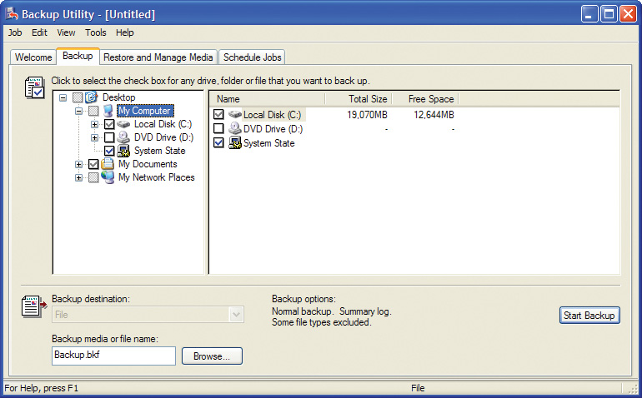
Enhancing an OS- Backup Software

Slide 5
Enhancing an OS
Anti-virus software
  Crucial utility
  Finds, blocks and removes viruses
  Must be updated regularly
  McAfee and Norton Anti-Virus

Slide 6
Enhancing an OS
Firewall
  is a part of a computer system or network that is designed to block unauthorized access while permitting authorized communications. It is a device or set of devices that is configured to permit or deny network transmissions based upon a set of rules and other criteria
  Protects your computer from intruders
  Makes computer invisible to hackers
  Can be hardware or software
  IP Tables, Access Lists are software to block intruder or hackers
  Cisco sells hardware firewalls
Notes:
Windows XP includes a firewall. Service pack 2 will turn this firewall on by default. To test your computer’s security visit www.grc.com and run the various Shields Up! tests

Slide 7
Behind the Scenes....!!
Most people never think about what actually goes on when they do something on the computer. To most people, whenever they command the computer to do something, it just does it. No questions asked !
It isn't as simple as that. Behind the facade of the user-friendly GUI (Graphical User Interface), many things have to be done by the system for the command to be carried out.

Slide 8
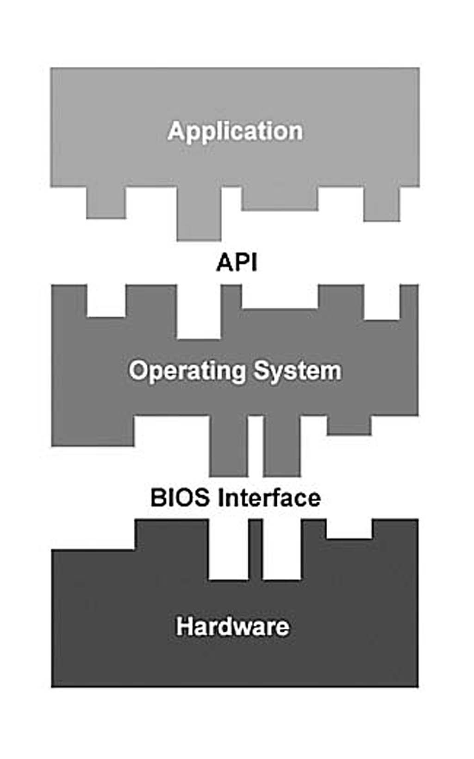
Layered Architecture
The computer system can be visualized as three separate layers that communicate with each other through different interfaces.
In our layered system, the application is the highest level. It cannot directly interact with the hardware. It can only communicate with the operating system through the API or Application Program Interface.

Slide 9
Application Programming Interface (API)
The API is a set of common functions that the application calls upon to get the operating system to do what it wants. Because the API is operating system-specific, it differs from operating system to operating system.
However, irrespective of the operating system, the API allows the application to get the job done without knowing how the operating system does it. The application doesn't need to know anything about the computer's hardware.

Slide 10
Basic Input Output System (BIOS)
The operating system then communicates to the BIOS what it needs to carry out the application's request. The operating system never communicates directly with the hardware.
The BIOS layer allows the operating system to support all manners of hardware. Each piece of hardware comes with its own BIOS and/or driver, which become part of the system's BIOS.
Therefore, the BIOS layer is dynamic and changes to match the computer's hardware configuration.

Slide 11
Importance of BIOS
The operating system only needs to know how to communicate with the BIOS layer. It is up to the BIOS layer to translate the operating system commands into action by the hardware.
Without the BIOS layer/Device Driver there's no way the operating system can access the hardware layer. The BIOS layer/ Device Driver is the operating system's key to the hardware layer. That's how important the BIOS layer is in the computer system.

Slide 12
Evolution of BIOS to EFI
The role of the BIOS has changed over time; today BIOS is a legacy system, superseded by the more complex Extensible Firmware Interface (EFI), but BIOS remains in widespread use,
EFI booting has only been supported in 64-bit x86 Windows since 2008. BIOS is primarily associated with the 16-bit, 32-bit, and the beginning of the 64-bit architecture eras, while EFI is used for some newer 32-bit and 64-bit architectures.
Today BIOS is primarily used for booting a system, and for certain additional features but otherwise is not used during the ordinary running of a system,
while in early systems (particularly in the 16-bit era), BIOS was used for hardware access – operating systems (notably MS-DOS) would call the BIOS rather than directly accessing the hardware. In the 32-bit era and later, operating systems instead generally directly accessed the hardware using their own device drivers.

Slide 13
Breakdown of BIOS Functions
Power-on self tests
System configuration utility
Bootstrap loader
BIOS interface

Slide 14
Power-On self Test (POST)
When you turn on the power to a computer, the first program that runs is usually a set of instructions kept in the computer's read-only memory (ROM). This code examines the system hardware to make sure everything is functioning properly.

Slide 15
System Configuration Utility
After the POST sequence completes, you are given the opportunity to access the system configuration utility. This utility allows you to configure and modify a range of features.
These BIOS features control every aspect of the computer, from the speed at which the processor runs to hard disk information.

Slide 16
Bootstrap Loader
The bootstrap loader is a small program that has a single function:
  It loads the operating system into memory and allows it to begin operation. In the most basic form, the bootstrap loader sets up the small driver programs that interface with and control the various hardware subsystems of the computer. It sets up the divisions of memory that hold the operating system, user information and applications.

Slide 17
Accessing the BIOS Setup Utility
The BIOS setup utility is only available for a few short seconds when you boot up your computer. If your operating system has already loaded up, you must reboot your computer before you can access the BIOS setup utility.
Normally Del, F2 and Esc Keys are used to halt the booting process and brings up the BIOS setup menu.

Slide 18
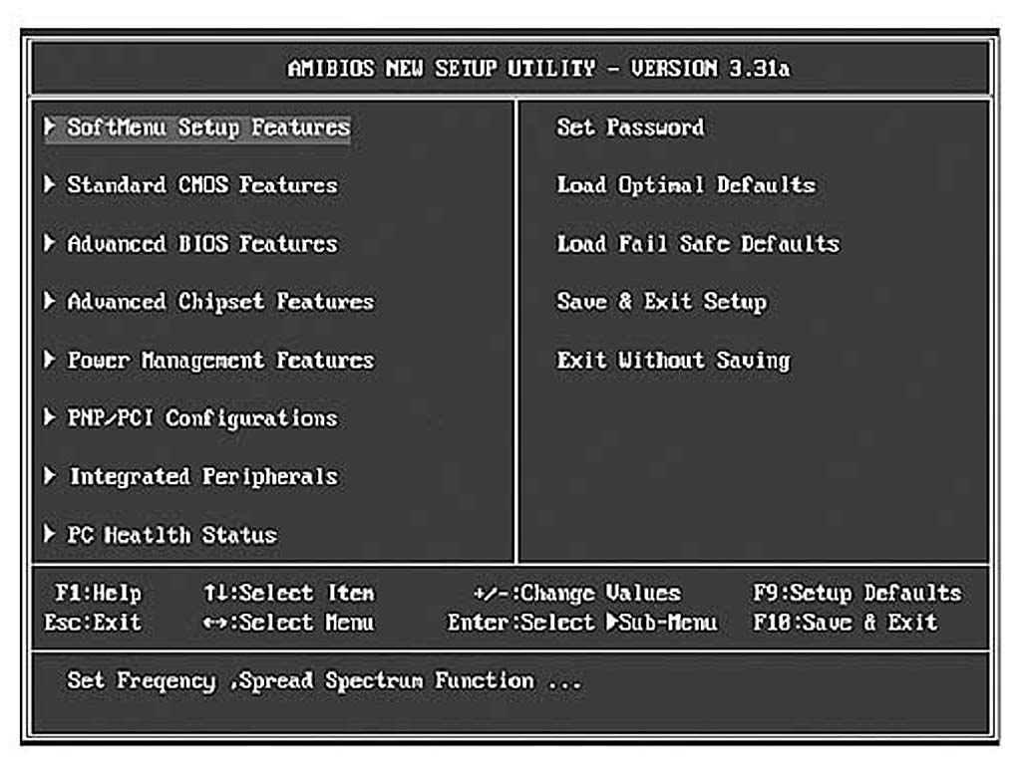
BIOS Setup Utility

